Slide 1
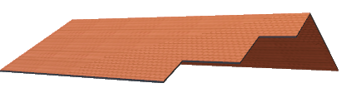
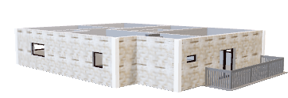
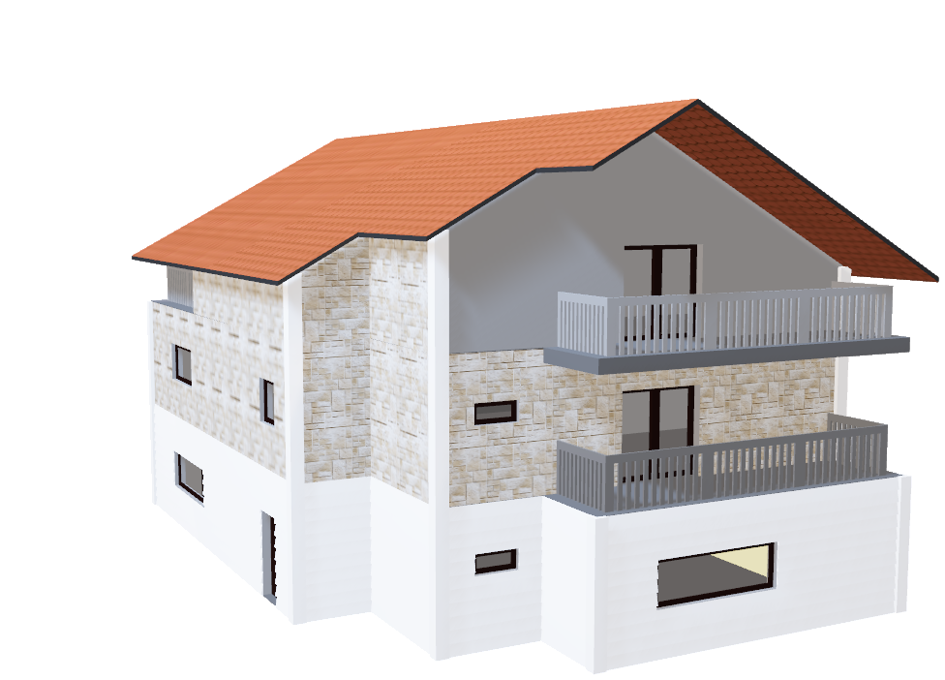
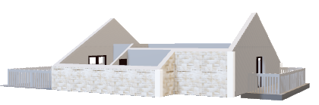
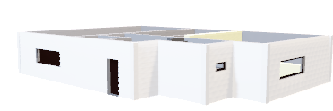
Housing Data Julius Andrey Mayo Rebekah Shaw Joseph Martinez Mindy Musch

Slide 2
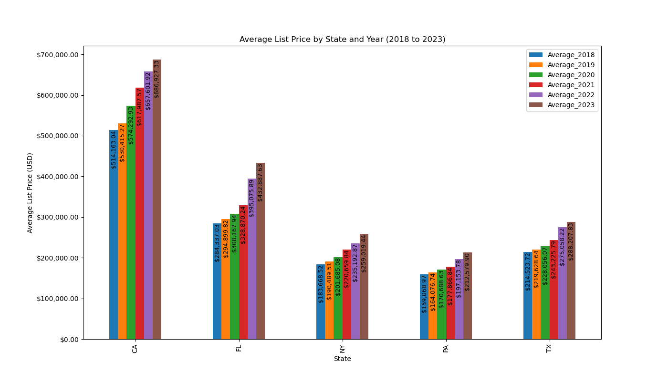

Slide 3
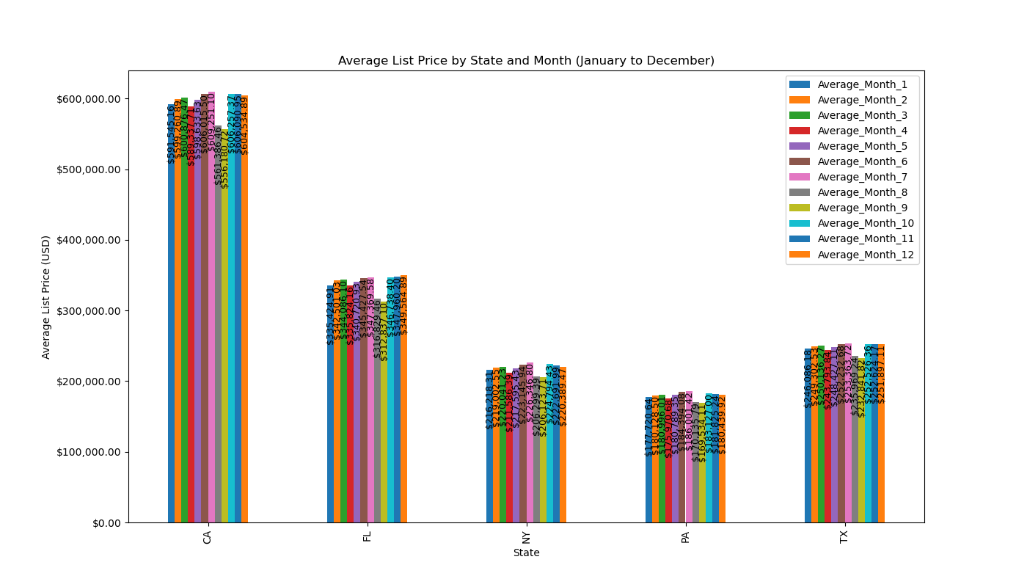
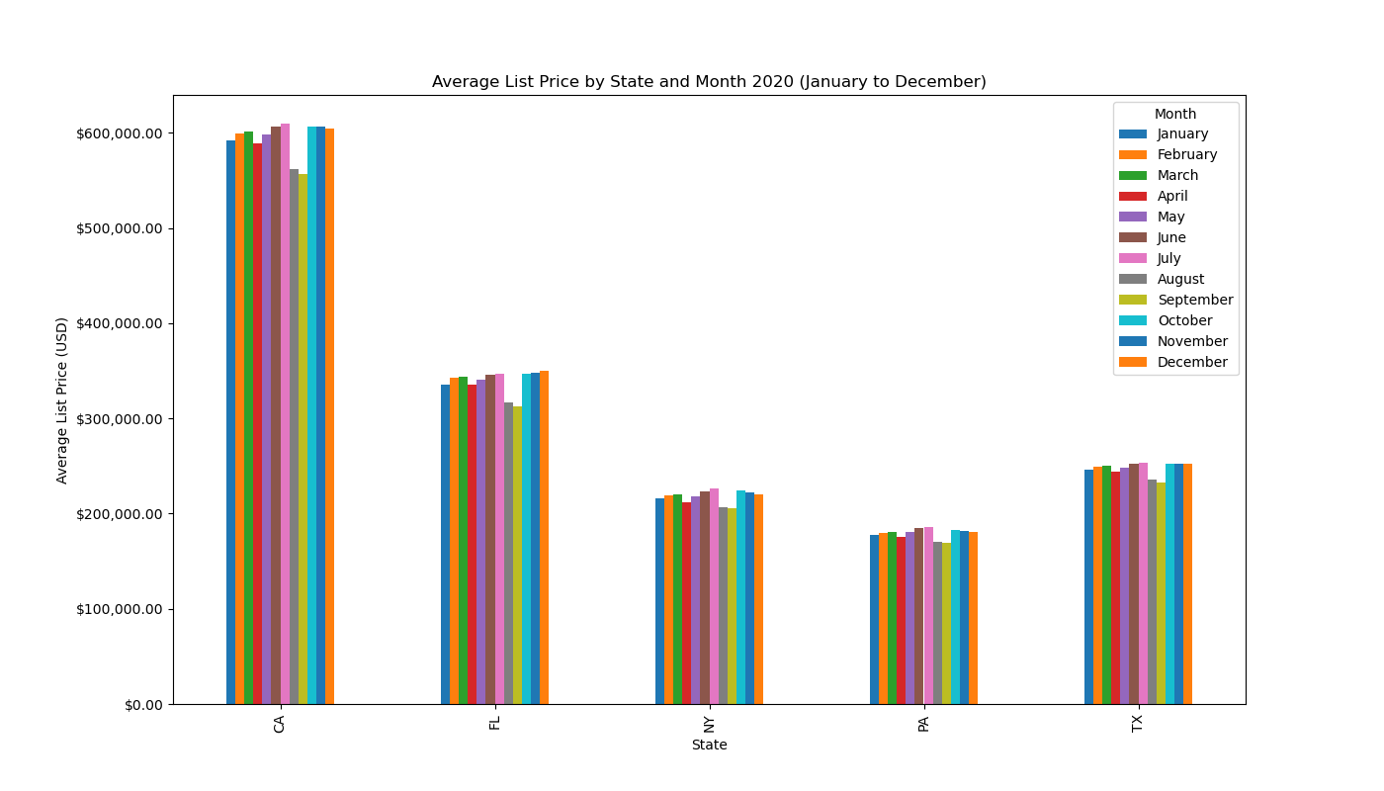

Slide 4
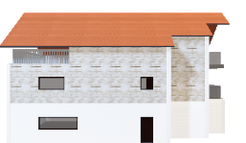
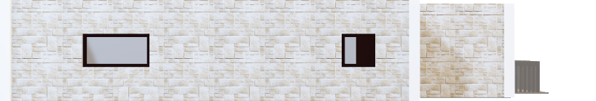
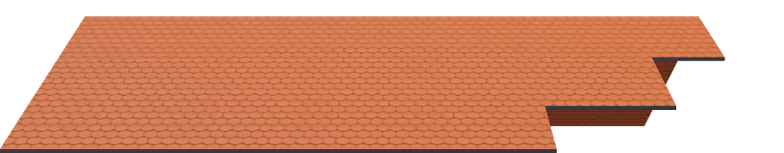

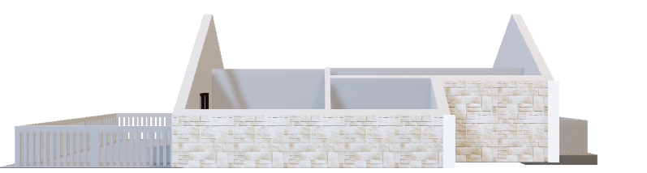
FRONT
ROOF:
Dazzling Mediterranean Roman style roof tiles
3rd FLOOR:
Natural stone complements the surrounding environment
2nd FLOOR:
Strategic window placement for an aesthetically pleasing exterior
1st FLOOR:
Whitewashed exterior provides a contemporary, yet classical, finish

Slide 6
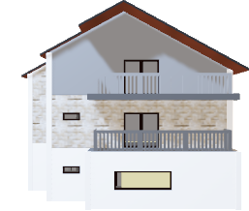
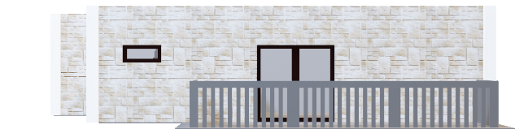


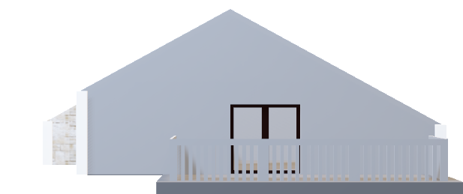
SIDE
ROOF:
Stepped rear design offers attractive viewing profile
3rd FLOOR:
Large terrace finished in cool grey for the perfect neutral effect
2nd FLOOR:
Stone tiling is delightfully accompanied by soft grey tones
1st FLOOR:
Panoramic window allows natural light to flow into the house

Slide 8
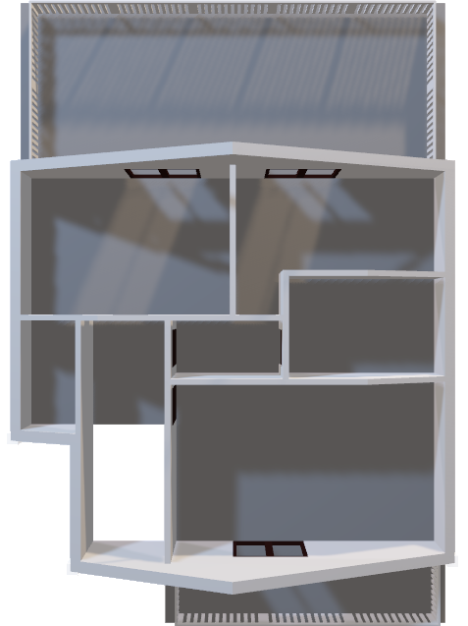
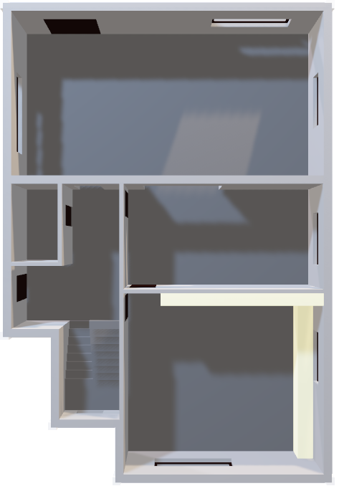
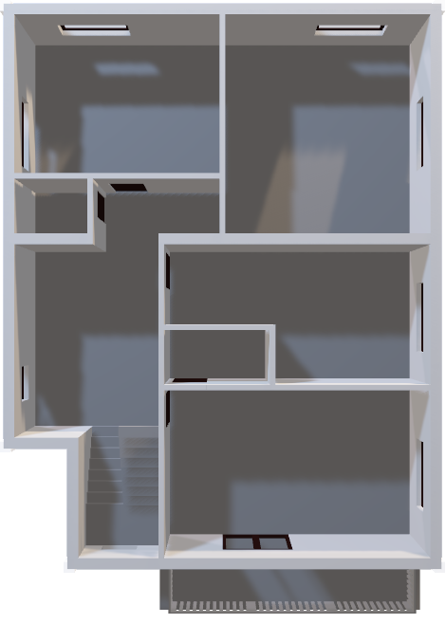
EXPERTLY DESIGNED TO MAKE THE MOST OF EVERY INCH OF SPACE, PROVIDING LUXURY LIVING FOR THE LARGE OR GROWING FAMILY
3RD FLOOR
2ND FLOOR
1ST FLOOR

Slide 9

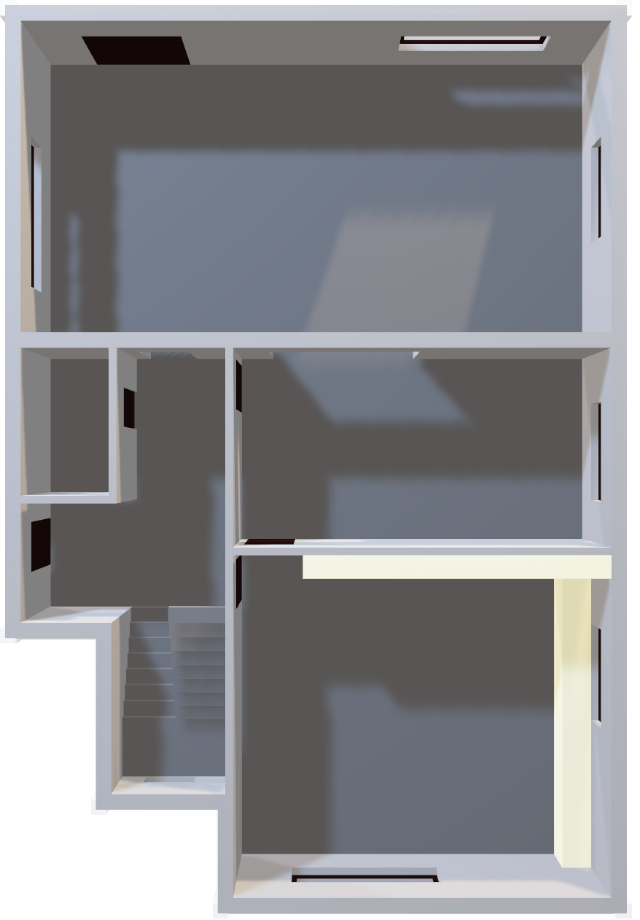
1ST FLOOR
Roof
A vast living/family room with large window for that all-important natural light. Spacious dining room with convenient access from large kitchen. Top quality, bespoke kitchen units incorporating the latest technology and luxury materials. Expansive hallway and downstairs cloakroom.
3rd Floor
2nd Floor

Slide 10
LARGE, SPACIOUS ROOMS ON EACH LEVEL PROVIDE THE UNIQUE OPPORTUNITY FOR ALL THE FAMILY TO HAVE THEIR OWN PERSONAL SPACE
Roof
3RD FLOOR
2ND FLOOR
1ST FLOOR

Slide 11
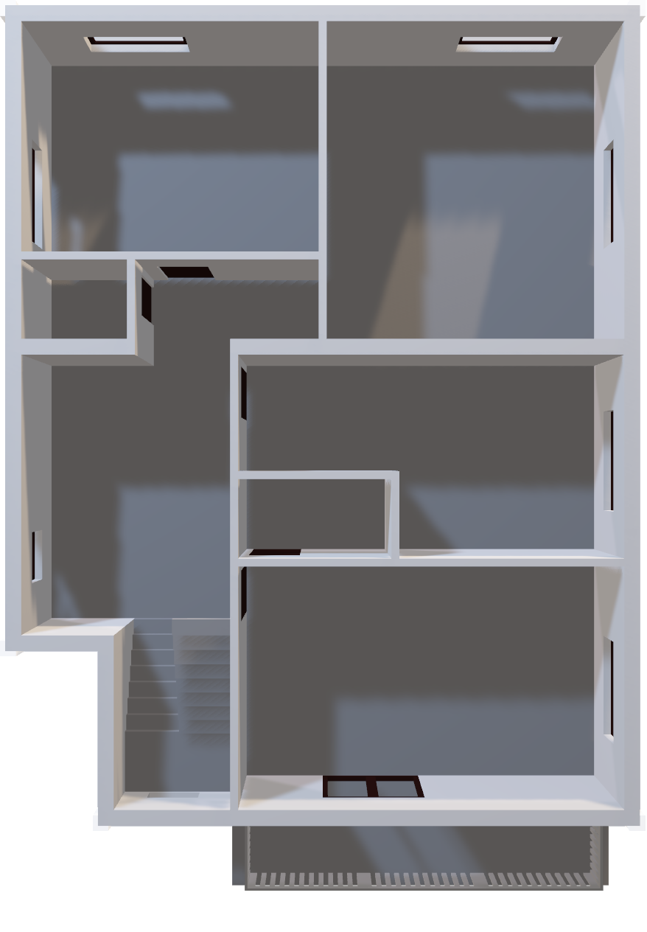

2ND FLOOR
Roof
Boasts three great sized bedrooms, the first with double doors leading to a balcony, and the others offering large windows to benefit from wonderful natural light. The family bathroom provides bathtub and separate shower unit, and is furnished to the highest of your personalized specifications.
3rd Floor
1st Floor

Slide 12
MULTIPLE CHOICES FOR EXPLORING ZILLOW DATA: Number of Listings, Median List Prices,
Roof
3RD FLOOR
2ND FLOOR
1ST FLOOR

Slide 13

SUMMARY
Roof
2nd Floor
1st Floor

